Slide 1
Rice Image Classification
Ilan Sirisky, Eldad Tsemach

Slide 2
Abstract
Rice, which is among the most widely produced grain products worldwide, has many genetic varieties. These varieties are separated from each other due to some of their features. These are usually features such as texture, shape, and colour. With these features that distinguish rice varieties, it is possible to classify and evaluate the quality of seeds.

Slide 3
Related Work
In a study in the literature, a two-class dataset containing 1700 rice data was carried out and 98.5% classification success was achieved using the SVM algorithm. Evaluation and analysis the chalkiness of connected rice kernels based on image processing technology and support vector machine - ScienceDirect
In another study, 843 pieces of data were examined from sixteen classes and 87.16% accuracy was obtained using the SVM algorithm. A survey of deep neural network architectures and their applications - ScienceDirect
In additional study, which used three classes and 7399 pieces of data, a 95.5% success rate was achieved with the deep CNN algorithm. A Deep Convolutional Neural Network Architecture for Boosting Image Discrimination Accuracy of Rice Species | SpringerLink

Slide 4
About the data
Dataset belonging to five rice varieties as Arborio, Basmati, Ipsala, Jasmine and Karacadag. The dataset consists of 25,000 rice grain images, 5,000 from each variety.
In RGB images contained in this dataset, the size of the image in which each grain of rice is located is 250 × 250 pixels.
We split the data into 80% training and 20% testing, for each class, we will have approximately 4000 images in the train set, 200 images in testing set and 800 images in validation set.
Link to dataset:
https://www.kaggle.com/datasets/muratkokludataset/rice-image-dataset

Slide 5
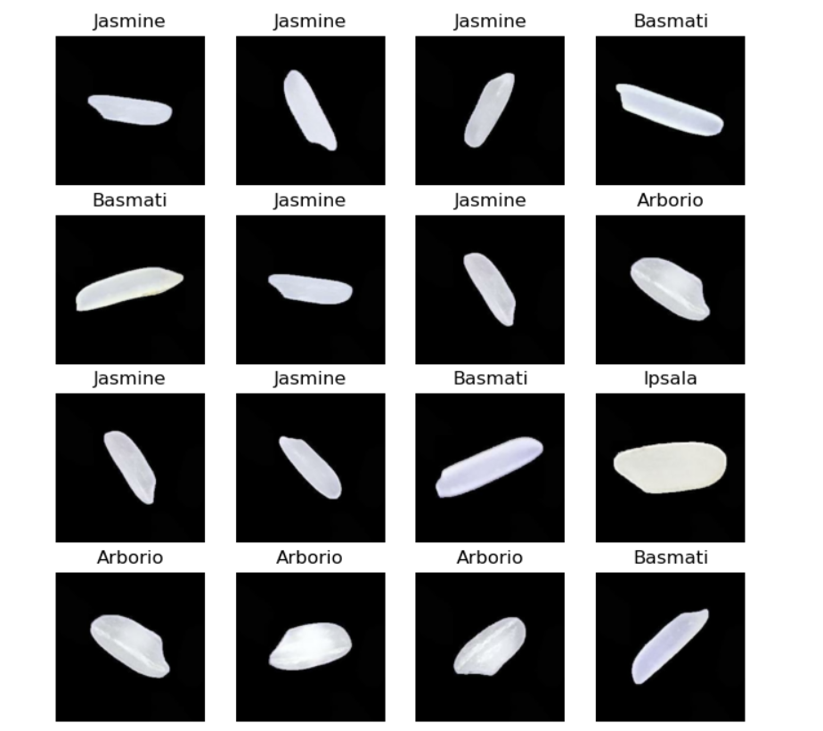
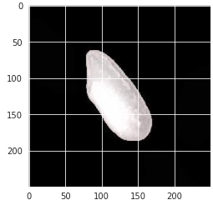
Visualization of the Data
The rice types
Image dimensions

Slide 6
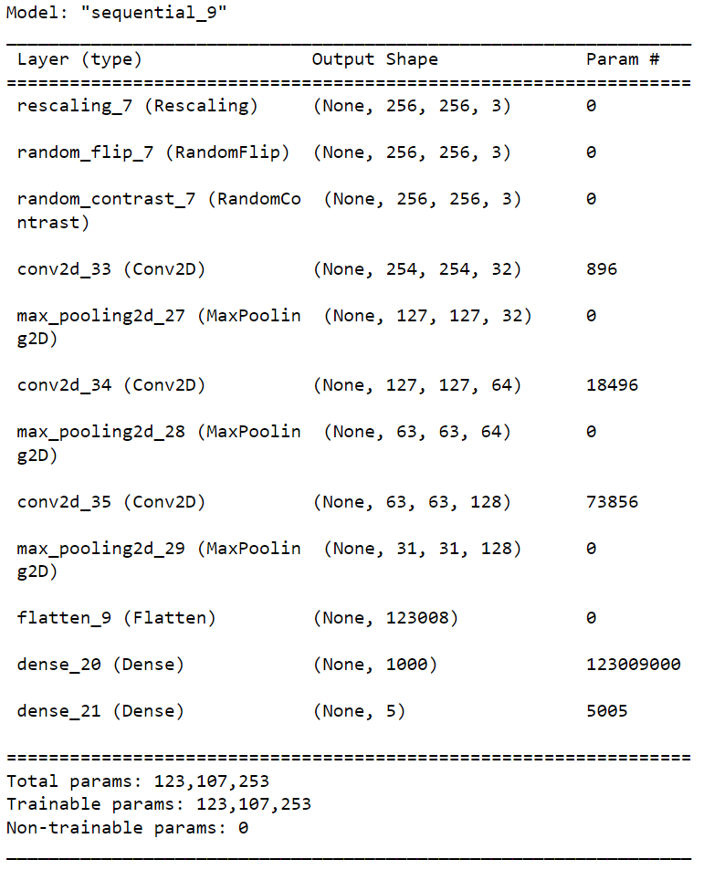
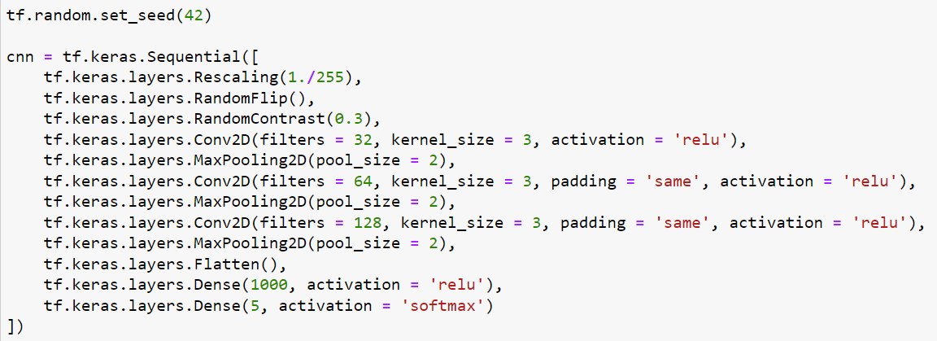
Project Description
We used a CNN model to classify the data, The model is a Sequential model, which means that the layers are added to the model in a linear stack, one after the other.

Slide 7
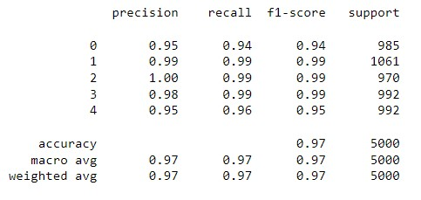
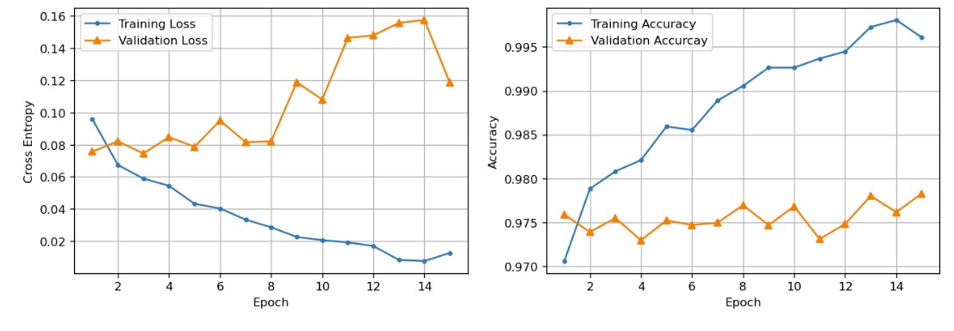
Conclusion
We ended up running the model with 15 epochs and a batch size of 50 and got 97.85% accuracy of classifying the types of the rice.
Confusion Matrix
Train Validation history

Slide 8
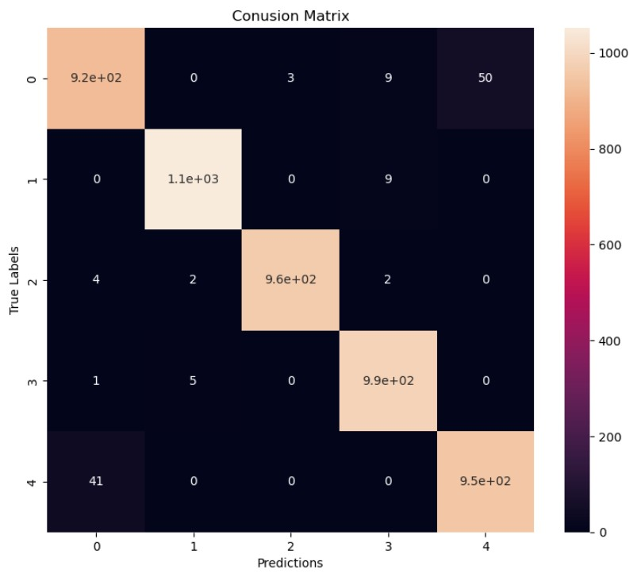

Slide 9
Thank you!

